Slide 1
Thermodynamics
Thermodynamics deals with the relations among heat, work and properties of system which are in equilibrium.
System:
A thermodynamic system is defined as a quantity of matter or a region in space which is selected for the study.
Surroundings:
The mass or region outside the system is called surroundings.
Boundary:
The real or imaginary surfaces which separates the system and surroundings is called boundary.

Slide 2
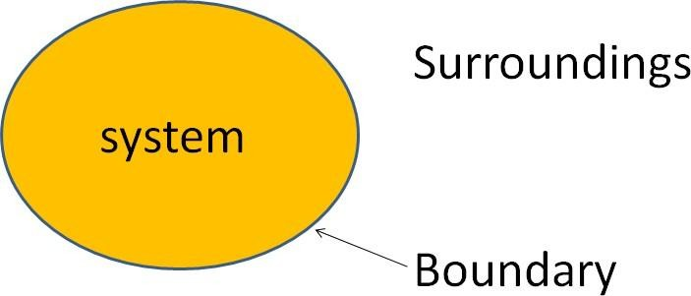
Types of thermodynamic system
On the basis of mass and energy transfer the thermodynamic system is divided into three types.
1. Closed system
2. Open system
3. Isolated system

Slide 3
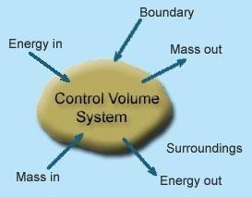
Control Volume:
It’s a system of fixed volume.
This type of system is usually referred to as "open system” or a "control volume"
Mass transfer can take place across a control volume.
Energy transfer may also occur into or out of the system.
Control Surface- It’s the boundary of a control volume across which the transfer of both mass and energy occur.
The mass of a control volume (open system) may or may not be fixed.

Slide 4
Sl.No | Macroscopic Approach | Microscopic Approach
1 | In this approach a certain quantity of matter is considered without taking into account the events occurring at molecular level. | The matter is considered to be comprised of a large number of tiny particles known as molecules, which moves randomly in chaotic fashion. The effect of molecular motion is considered.
2 | Analysis is concerned with overall behavior of the system. | The Knowledge of the structure of matter is essential in analyzing the behavior of the system.
3 | This approach is used in the study of classical thermodynamics. | This approach is used in the study of statistical thermodynamics.
4 | A few properties are required to describe the system. | Large numbers of variables are required to describe the system.
5 | The properties like pressure, temperature, etc. needed to describe the system, can be easily measured. | The properties like velocity, momentum, kinetic energy, etc. needed to describe the system, cannot be measured easily.
6 | The properties of a system is given by its average values. | The properties are defined for each molecule individually.
7 | This approach requires simple mathematical formulas for analyzing the system. | No. of molecules are very large so it requires advanced statistical and mathematical method to explain any change in the system.

Slide 5
Thermodynamic Equilibrium:
A thermodynamic system is said to exist in a state of thermodynamic equilibrium when no change in any macroscopic property is registered if the system is isolated from its surroundings.
Mechanical equilibrium: The criteria for Mechanical equilibrium are the equality of pressures.
Chemical equilibrium: The criteria for Chemical equilibrium are the equality of chemical potentials.
Thermal equilibrium: The criterion for Thermal equilibrium is the equality of temperatures.

Slide 6
Property:
Intensive properties: The properties which are independent of the mass of the system.
For example: Temperature, pressure and density are the
intensive properties.
Extensive properties: The properties which depend on the size or
extent of the system are called extensive properties.
For example: Total mass, total volume and total momentum.
Process:
When the system undergoes change from one thermodynamic state to final state due change in properties like temperature, pressure, volume, the system is said to have undergone thermodynamic process.
Various types of thermodynamic processes are: Isothermal process, Adiabatic process, Isochoric process, Isobaric process and Reversible process.

Slide 7
Cycle:
Thermodynamic cycle refers to any closed system that undergoes various changes due to temperature, pressure, and volume, however, its final and initial state are equal.
Reversibility:
Reversibility, in thermodynamics, a characteristic of certain processes (changes of a system from an initial state to a final state spontaneously or as a result of interactions with other systems) that can be reversed, and the system restored to its initial state, without leaving net effects in any of the systems involved.

Slide 8
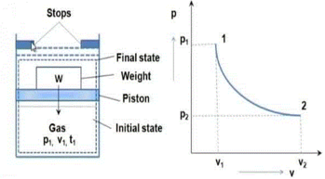
Quasi-static process
When a process is processing in such a way that system will be remained infinitesimally close with equilibrium state at each time, such process will be termed as quasi static process or quasi equilibrium process.

Slide 9
Irreversible Process:
The irreversible process is also called the natural process because all the processes occurring in nature are irreversible processes.
In the irreversible process the initial state of the system and surroundings cannot be restored from the final state.
During the irreversible process the various states of the system on the path of change from initial state to final state are not in equilibrium with each other.
During the irreversible process the entropy of the system increases decisively and it cannot be reduced back to its initial value.

Slide 10
Causes of Irreversibility:
Friction: Friction is invariably present in real systems. It causes irreversibility in the process as work done does not show an equivalent rise in the kinetic or potential energy of the system.
Free expansion: Free expansion refers to the expansion of unresisted type such as expansion in a vacuum. During this unresisted expansion the work interaction is zero, and without the expense of any work, it is not possible to restore initial states. Thus, free expansion is irreversible.
Heat transfer through a finite temperature difference: Heat transfer occurs only when there exists temperature difference between bodies undergoing heat transfer.
Non equilibrium during the process: Irreversibilities are introduced due to lack of thermodynamic equilibrium during the process. Non-equilibrium may be due to mechanical inequilibrium, chemical inequilibrium, thermal inequilibrium, electrical inequilibrium, etc.

Slide 11
Heat:
It is the energy in transition between the system and the surroundings by virtue of the difference in temperature.
Work:
Thermodynamic definition of work: Positive work is done by a system when the sole effect external to the system could be reduced to the rise of a weight.
Point and Path functions:
Point function does not depend on the history (or path) of the system. It only depends on the state of the system.
Examples of point functions are: temperature, pressure, density, mass, volume, enthalpy, entropy, internal energy etc.

Slide 12
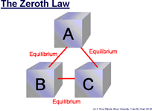
Zeroth Law of Thermodynamics:
The Thermodynamics Zeroth Law states that if two systems are at the same time in thermal equilibrium with a third system, they are in equilibrium with each other.

Slide 13
Principles of Thermometry
Thermometry is the science and practice of temperature measurement. Any measurable change in a thermometric probe can be used to mark temperature levels, that should later be calibrated against an internationally agreed unit.

Slide 14
Liquid (in glass) thermometers
A liquid-in-glass thermometer measures temperature based on the thermal expansion of mercury or spirit/ alcohol in a glass container.
The boiling point of mercury is 356.72 °C, and its melting point is -38.86 °C.
The boiling point of methyl alcohol is 64.65 °C and its melting point is -97.78 °C.
Mercury has low thermal capacity, high heat conductivity, inertness in relation to a glass capillary tube and a high boiling point, it is an ideal thermometric liquid except for its relatively high melting point.
Hence mercury thermometers are used for ordinary meteorological observations, and spirit thermometers are used for measurements involving temperatures below the melting point of mercury.
Thermometry is sometimes split in metrological studies in two subfields: contact thermometry and noncontact thermometry.

Slide 15
The liquid-in-glass thermometer consists of a capillary glass tube with a bulb at one end filled with a thermometric liquid, vacuumed and sealed.
By reading the position of the liquid level on a scale, a temperature value can be obtained.
Designs can be classified as either the sheathed type or the unsheathed type.
A sheathed thermometer consists of a bulb, a slender capillary glass tube connected to it, a milky-white scale plate attached to the capillary tube, and an outer glass tube that encloses them.
An unsheathed thermometer consists of a thick-walled capillary glass tube with a scale marked directly on it.

Slide 16
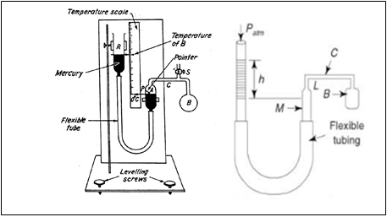
Constant Volume Gas Thermometers

Slide 17
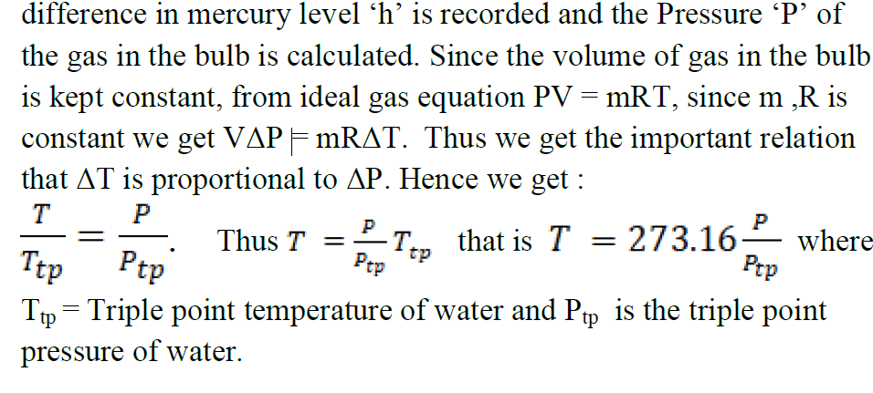

Slide 18
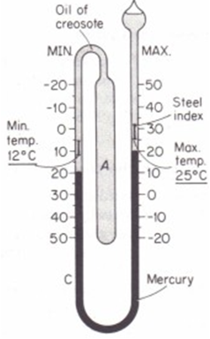
Six’s Maximum and Minimum thermometer (invented by James Six in 1782)

Slide 19
Scales of Temperature
There are three temperature scales in use Fahrenheit, Celsius and Kelvin. Fahrenheit temperature scale is a scale based on 32 for the freezing point of water and 212 for the boiling point of water, the interval between the two being divided into 180 parts.
The conversion formula for a temperature that is expressed on the Celsius (C) scale to its Fahrenheit (F) representation is:
F = 9/5 C + 32.

Slide 20
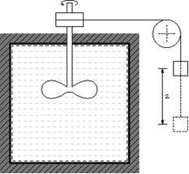
Joule’s experiment
Mgz = ΔQ

Slide 21
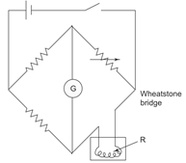
Resistance thermometer

Slide 22
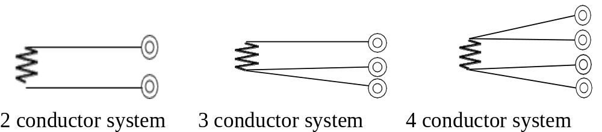

Slide 23
Internal Energy
Internal energy refers to the energy of the molecules of a substance which undergoes ceaseless motion and thereby has kinetic energy. The addition of heat to a substance increases this molecular activity, and thus causes an increase in its internal energy.

Slide 24
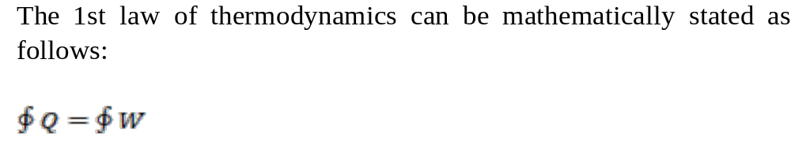
First Law of Thermodynamics
The First law of thermodynamics states that energy is neither created nor destroyed. Thus, the total energy of the universe is a constant.

Slide 25
Corollary 1
dU = dQ - dW
Here U is property of system and is called as total energy that includes internal energy, kinetic energy, potential energy, electrical energy, magnetic energy, chemical energy, etc.

Slide 26
Corollary 2:
For the isolated system, heat and work both interactions are absent (dQ = 0, dW = 0) and U is a constant. Energy can neither be created nor be destroyed; but it can be converted from one form to other.

Slide 27
Corollary 3:
A perpetual motion machine of the first kind (PMM1) is impossible as it violates the 1st law of thermodynamics.
e.g.: An electric heater that consumes 1KW of electricity cannot produce more than 1KW heat.

Slide 28
Work done in Ideal gas process
Assume gas is in a container closed at one end. At the other end a tightly fitting moveable piston enables us to apply an external force
F_{ext} = -F_{gas} = -pA.
Suppose the piston moves a small distance dx to the right, external force (the environment) does an amount of work on the piston and therefore on the gas of
dW = Fext dx = - pAdx

Slide 29
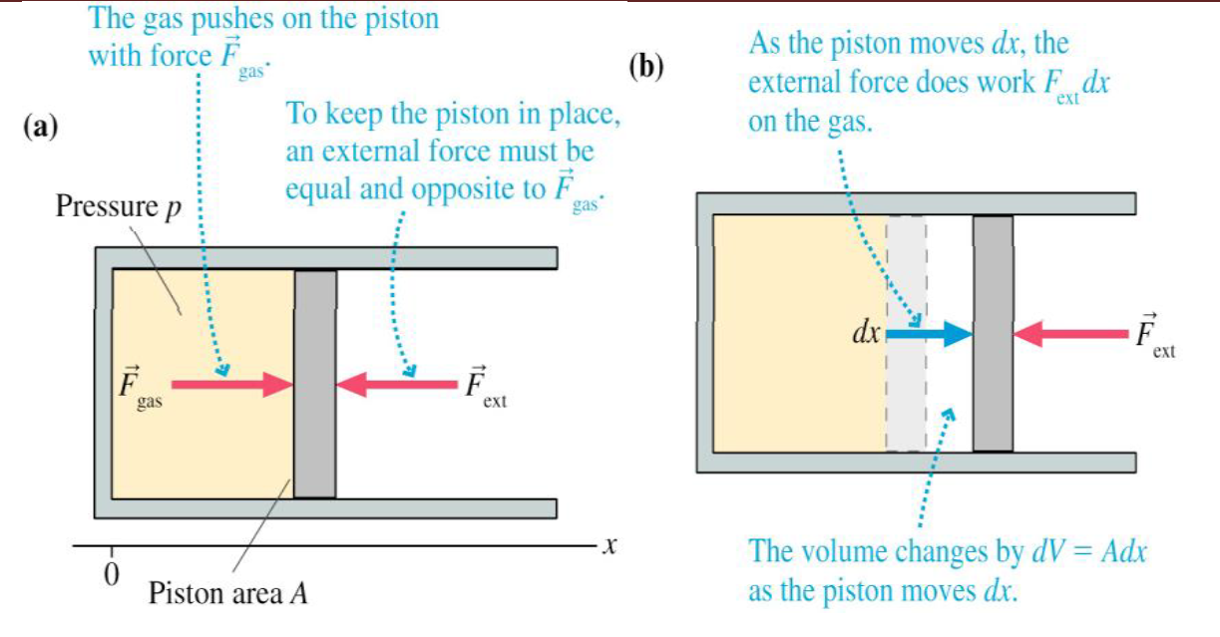

Slide 30
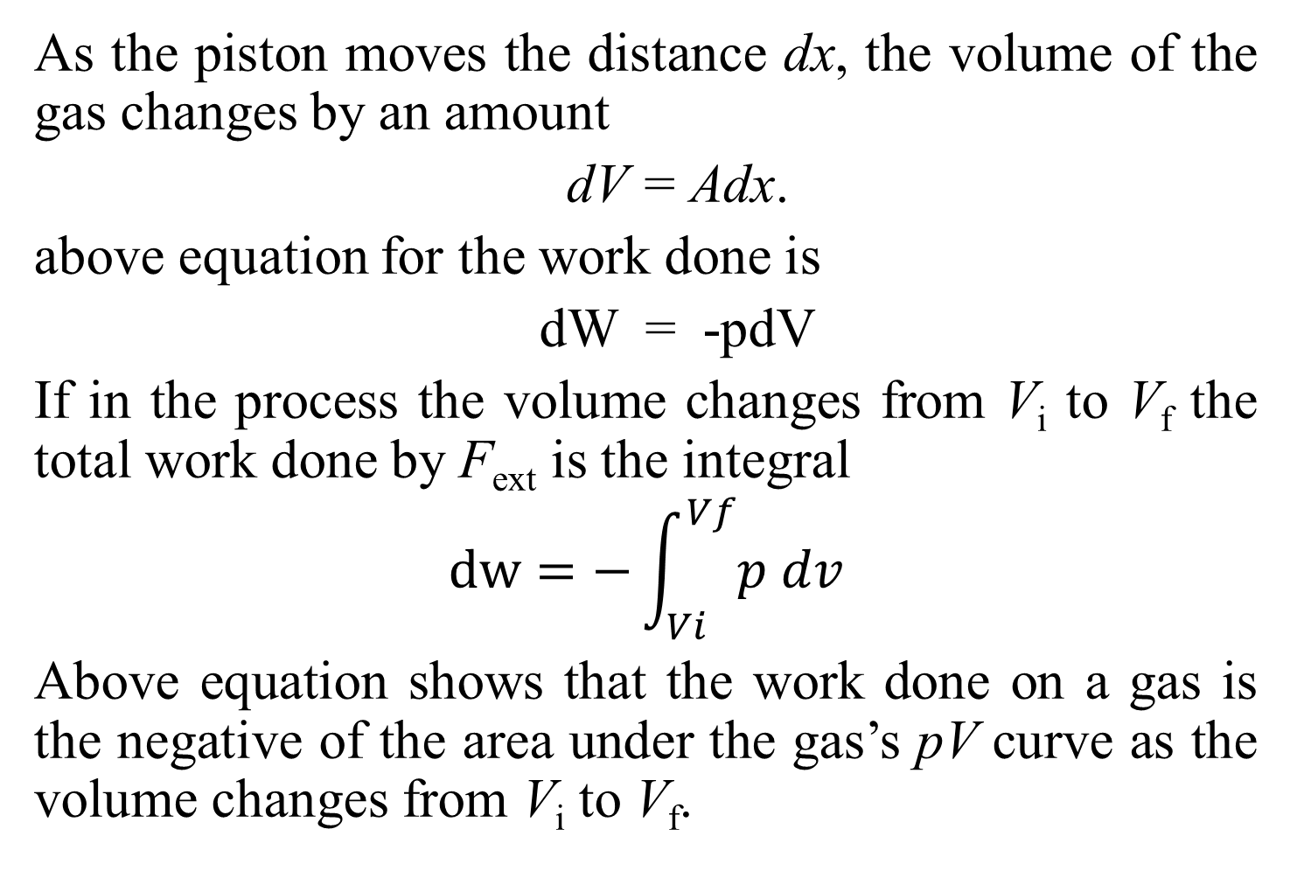
As the piston moves the distance dx, the volume of the gas changes by an amount
dV = Adx.
above equation for the work done is
dW = -pdV
If in the process the volume changes from V_{i} to V_{f} the total work done by F_{ext} is the integral
$$dw=−\int_{Vi}^{Vf}{p dv}$$
Above equation shows that the work done on a gas is the negative of the area under the gas’s pV curve as the volume changes from V_{i} to V_{f}.

Slide 31
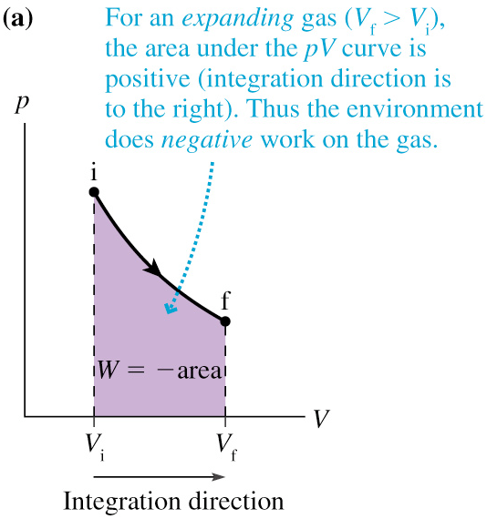
Fig (a) below shows gas expansion. The area under the pV curve is positive. This means that the environment does a negative amount of work.

Slide 32
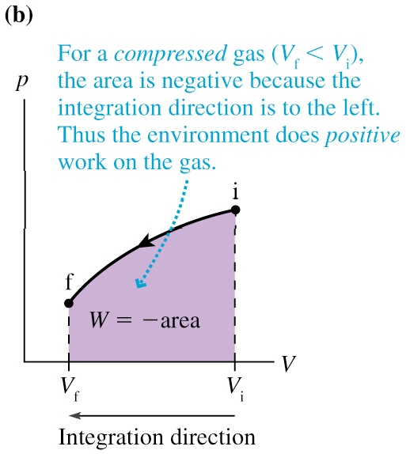
Figure (b) below shows a contraction. The area is negative (the integration is performed from a larger to a smaller volume) so the work done by the environment on the gas is positive.

Slide 33
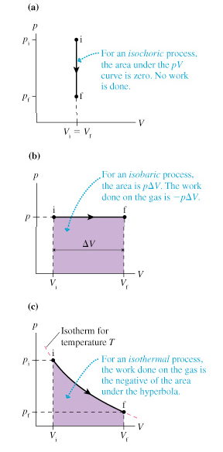

Slide 34
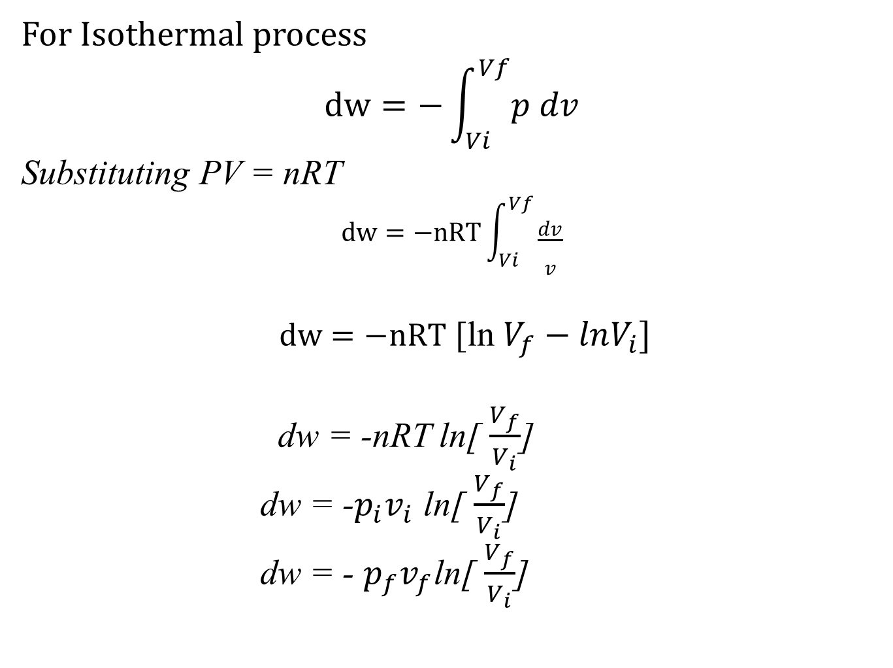
For Isothermal process
$$dw=−\int_{Vi}^{Vf}{p dv}$$
Substituting PV = nRT
$$dw=−nRT\int_{Vi}^{Vf}{\frac{dv}{v}}$$
$dw=−nRT$ [ln $V_{f}−lnV_{i}]$
dw = -nRT ln[ $\frac{V_{f}}{V_{i}}$]
dw = -$p_{i}v_{i}$ ln[ $\frac{V_{f}}{V_{i}}$]
dw = - $p_{f}v_{f}$ln[ $\frac{V_{f}}{V_{i}}$]

Slide 35
Adiabatic Expansion of Gas:
Adiabatic process in which there is not heat transfer takes place between system and surroundings.
Thus in terms of the 1st Law of Thermodynamics, we can say that for a thermodynamic process,
dQ = dU + dW = 0

Slide 36
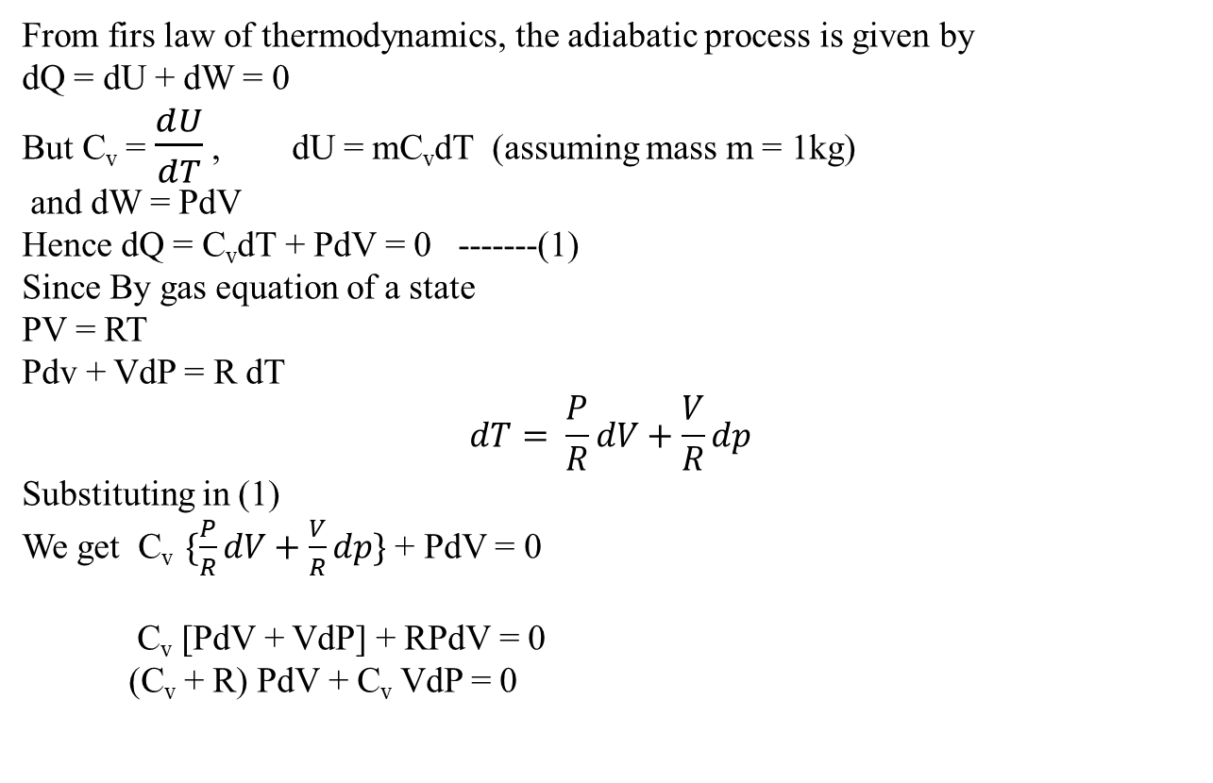
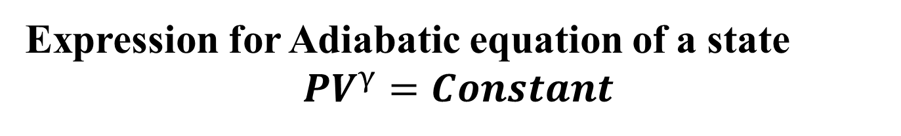
Expression for Adiabatic equation of a state
$${PV}^{γ}=Constant$$
From firs law of thermodynamics, the adiabatic process is given by
dQ = dU + dW = 0
But C_{v} = $\frac{dU}{dT}$ , dU = mC_{v}dT (assuming mass m = 1kg)
and dW = PdV
Hence dQ = C_{v}dT + PdV = 0 -------(1)
Since By gas equation of a state
PV = RT
Pdv + VdP = R dT
$$dT= \frac{P}{R}dV+\frac{V}{R}dp$$
Substituting in (1)
We get C_{v} $\{\frac{P}{R}dV+\frac{V}{R}dp\}$ + PdV = 0
C_{v} [PdV + VdP] + RPdV = 0
(C_{v} + R) PdV + C_{v} VdP = 0

Slide 37
But C_{p} – C_{v} = R, which means C_{p} = C_{v} + R
Thus we get : C_{p}PdV + C_{v} VdP = 0
Dividing throughout by C_{p}PV, we get :
dV/V + (C_{v}/C_{p})(dP/P) = 0
(C_{p}/ C_{v}) dV/V + dP/P = 0
ϒ (dV/V) + (dP/P) = 0
Hence, after integration, we get PV^{ϒ} = Constant

Slide 38
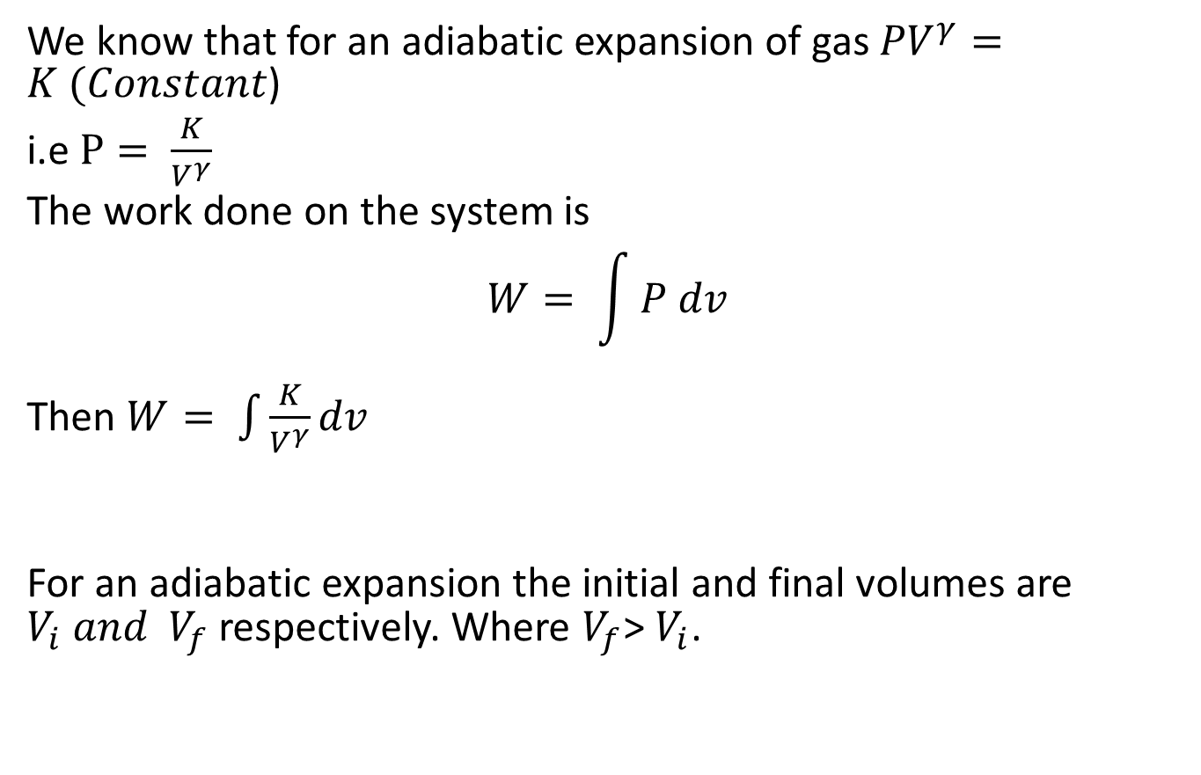
Work done in adiabatic expansion of gas
We know that for an adiabatic expansion of gas ${PV}^{γ}=K (Constant$)
i.e $P= \frac{K}{V^{γ}}$
The work done on the system is
$$W= \int{P dv}$$
Then $W= \int{\frac{K}{V^{γ}}dv}$
For an adiabatic expansion the initial and final volumes are $V_{i} and V_{f}$ respectively. Where $V_{f}$> $V_{i}$.

Slide 39
After integrating the above equation, we get : W = ∫dW = K∫V -ϒ dV
W = (K/(1 – ϒ))V (1-ϒ)
For adiabatic expansion, the initial and final volumes are Vi and Vf, where Vf > Vi
So work done in adiabatic expansion is W = (K/(1 – ϒ))[Vf (1-ϒ) - Vi (1-ϒ) ] = (K/(ϒ - 1))[Vi (1-ϒ) - Vf (1-ϒ) ]
W = (1/(ϒ - 1))[ (K/ Vi (ϒ-1) ) - (K/ Vf (ϒ-1) ) ]
Putting K = PiViϒ in the first term and K = PfVfϒ in the second term, we get :
W = (1/(ϒ - 1))[ (PiViϒ / Vi (ϒ-1) ) - (PfVfϒ / Vf (ϒ-1) ) ] = [ PiVi - PfVf ]/( ϒ - 1)
Thus W = [ PiVi - PfVf ]/( ϒ - 1)

Slide 40
Limitations of the First Law:
First law does not provide a clear idea about the direction of absorption or evolution of heat.
The first law of thermodynamics merely indicates that in any process there is a transformation between the various forms of energy involved in the process but has nothing to say regarding the feasibility of such transformation.
First law does not provide any information regarding the direction in which processes will take place or whether it is a spontaneous or a non-spontaneous process.

Slide 41
Thermal Reservoir:
A thermal reservoir is a large system from which a quantity of energy can be absorbed or added as heat without changing its temperature.
The atmosphere and sea are examples of thermal reservoirs.
Any physical body whose thermal energy capacity is large relative to the amount of energy it supplies or absorbs can be modelled as a thermal reservoir. A reservoir that supplies energy in the form of heat is called a source and one that absorbs energy in the form of heat is called a sink.

Slide 42
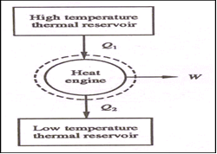
Heat Engine:
It is a cyclically operating device which absorbs energy as heat from a high temperature reservoir, converts part of the energy into work and rejects the rest of the energy as heat to a thermal reservoir at low temperature.
The working fluid is a substance, which absorbs energy as heat from a source, and rejects energy as heat to a sink.

Slide 43
Numericals
1)A turbine is supplied with steam at a gauge pressure of 1.4 MPa. After expansion in the turbine the steam flows into a condenser which is maintained at a vacuum of 710 mm Hg. The barometric pressure is 772 mm Hg. Express the inlet and exhaust steam pressure in pascals (absolute). Take the density of mercury as 13.6 × 10³ kg/m³

Slide 44
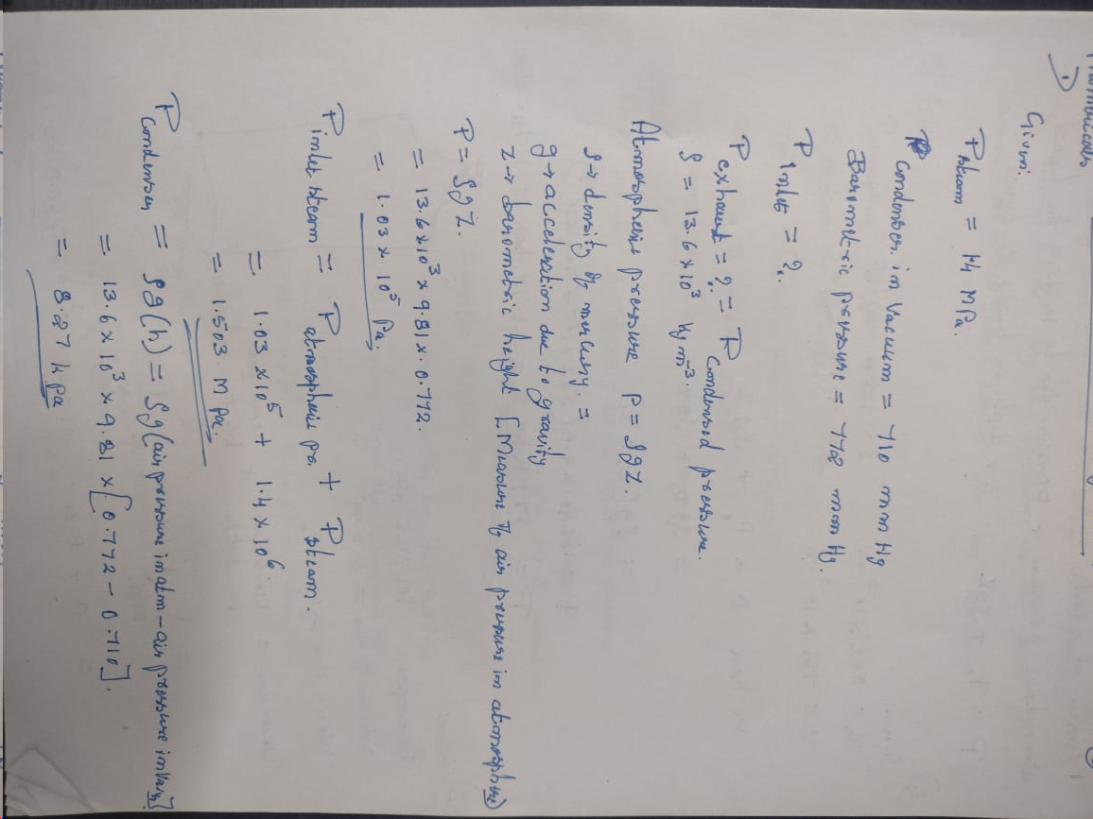

Slide 45
2) The pressure of gas in a pipe line is measured with a mercury manometer having one limb open to the atmosphere. If the difference in the height of mercury in the two limbs is 562 mm, calculate the gas pressure. The barometer reads 761 mm Hg, the acceleration due to gravity is
9.79 m/s², and the density of mercury is 13,640 kg/m³.

Slide 46
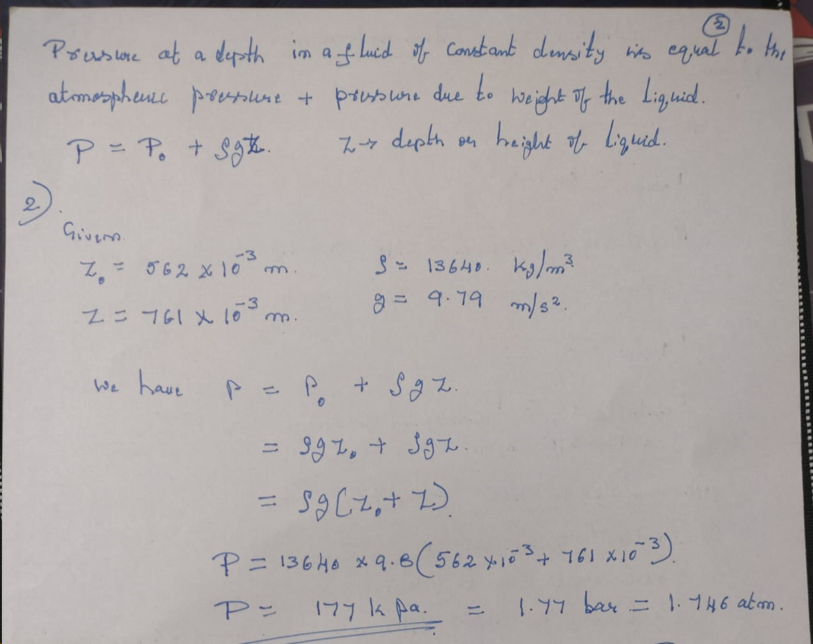

Slide 47
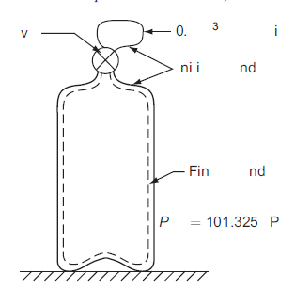
3) When the valve of the evacuated bottle is opened, atmospheric air rush pressure is 101.325 kPa, and 0.6 m³ of air (measured at atmospheric conditions) enters into the bottle, calculate the work done by air.

Slide 48
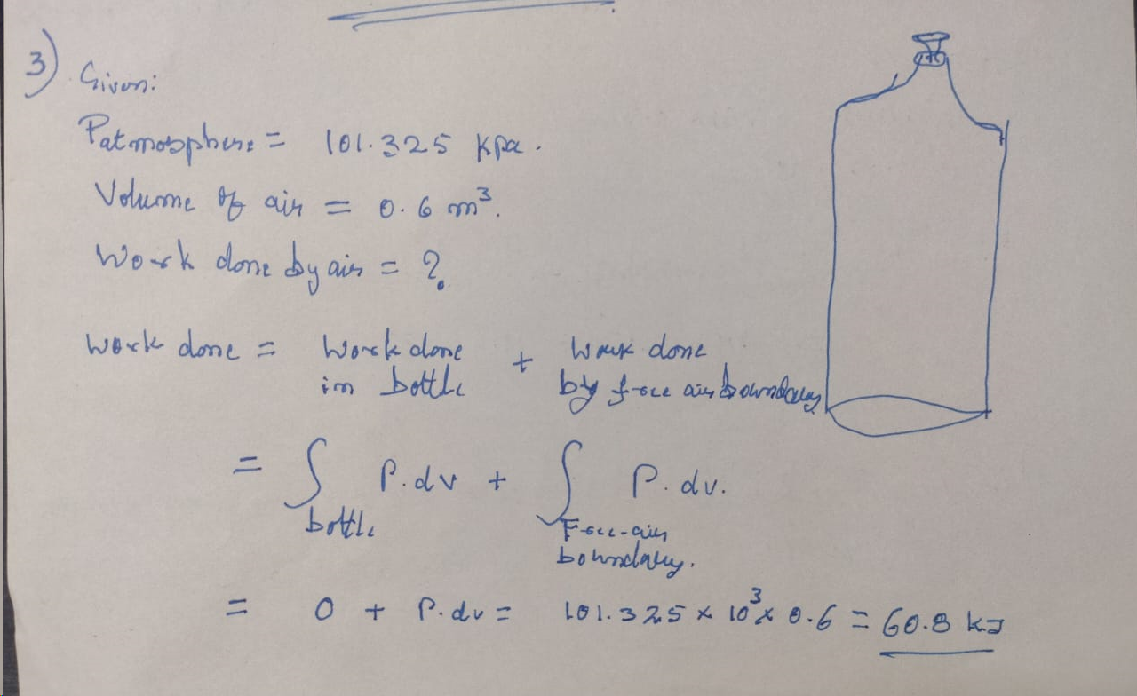

Slide 49
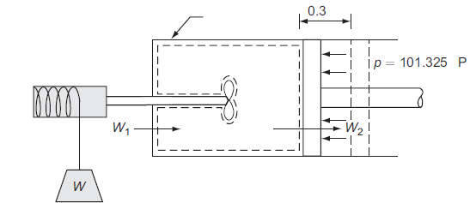
4) A piston and cylinder machine containing a fluid system has a stirring device in the cylinder. The piston is frictionless, and it is held down against the fluid due to the atmospheric pressure of 101.325 kPa. The stirring device is turned 10,000 revolutions with an average torque against the fluid of 1.275 mN. Meanwhile the piston of 0.6 m diameter moves out 0.8 m. Find the net work transfer for the system.

Slide 50
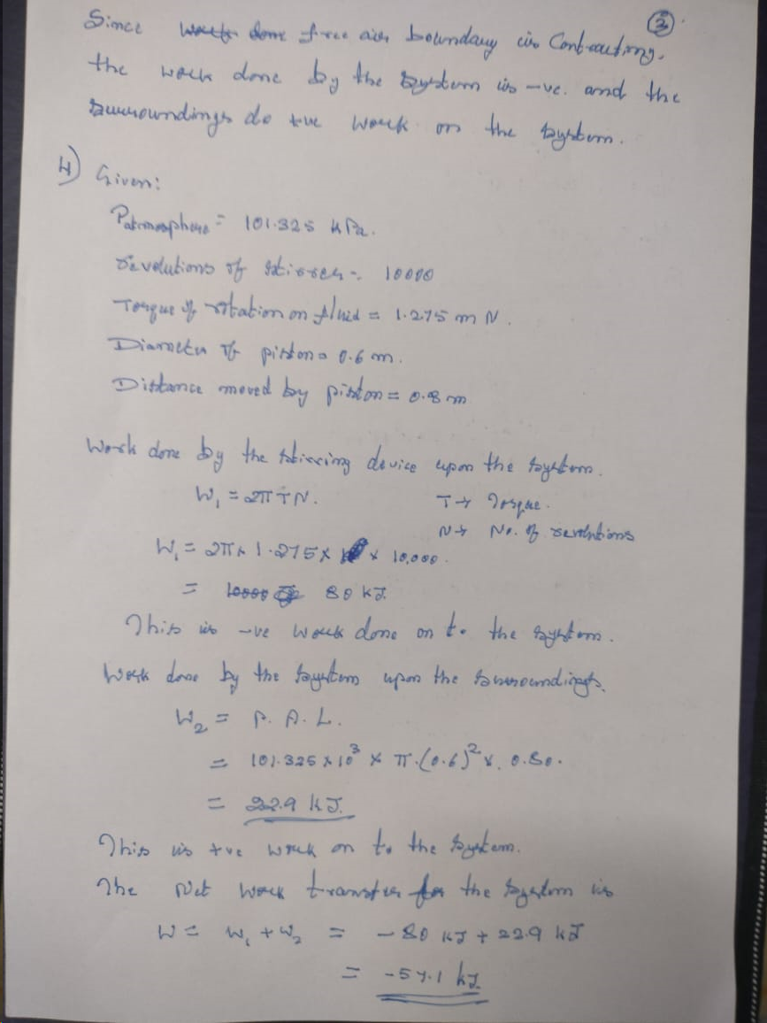

Slide 51
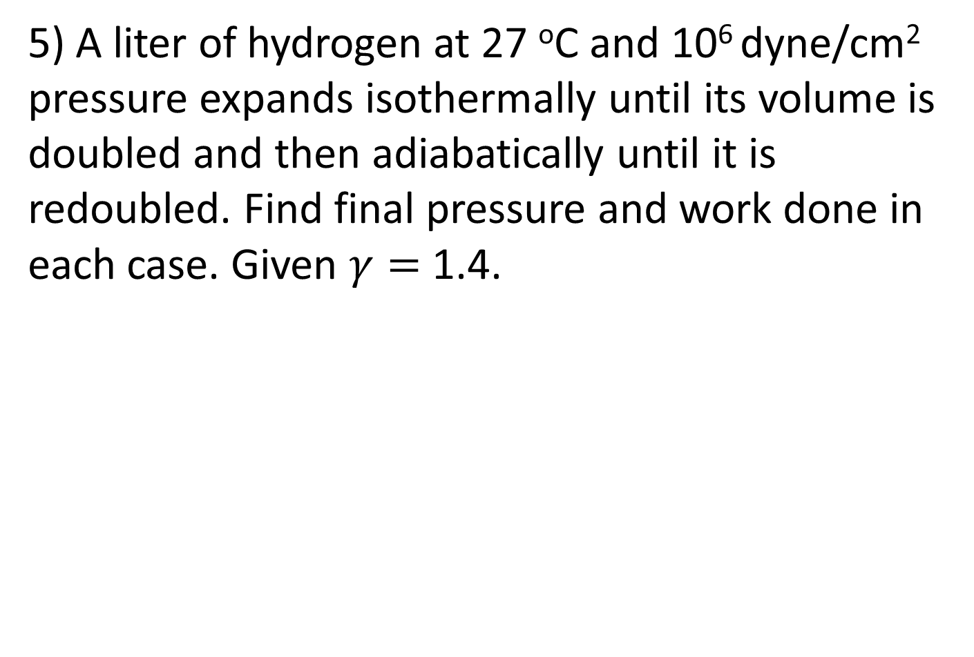
5) A liter of hydrogen at 27 ºC and 10⁶ dyne/cm² pressure expands isothermally until its volume is doubled and then adiabatically until it is redoubled. Find final pressure and work done in each case. Given $γ=$ 1.4.

Slide 52
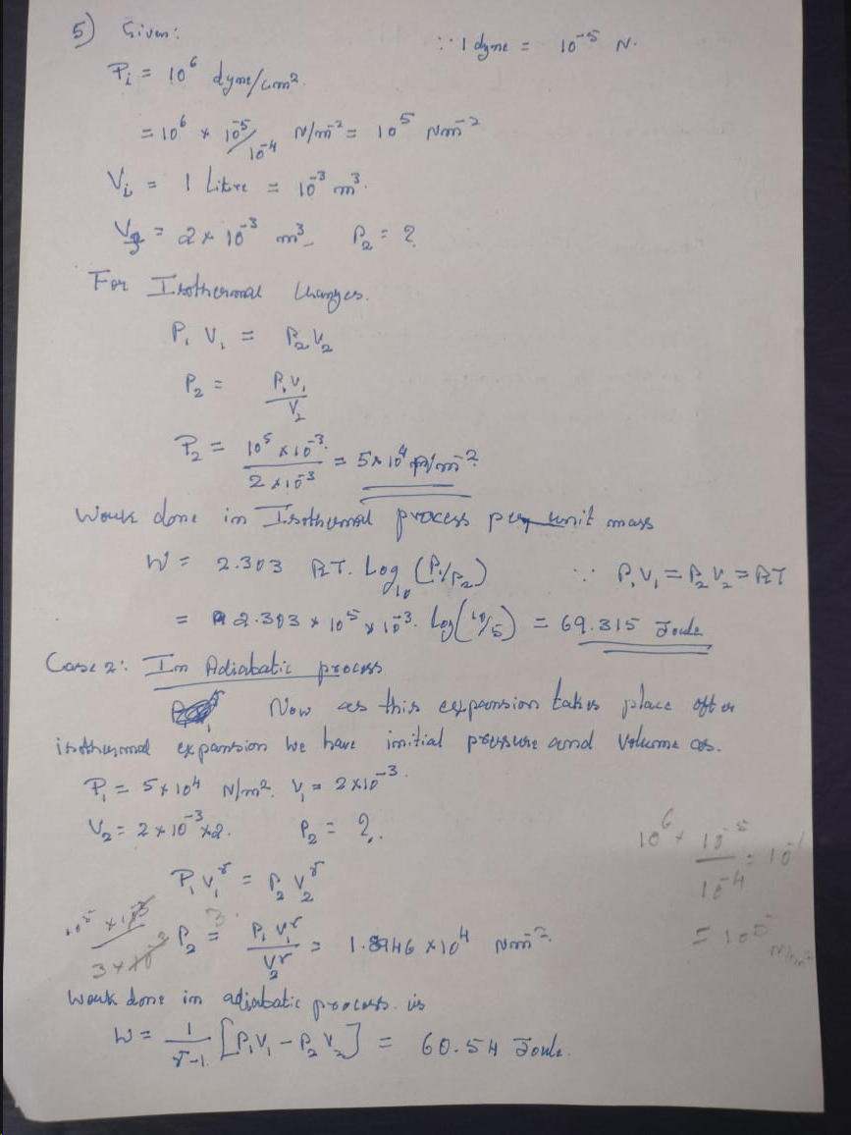

Slide 53
6) It is required to melt 5 tonnes per hour of iron from a charge at 15 ºC to molten metal at 1650 ºC. The melting point is 1535 ºC, and the latent heat is 270 kJ kg⁻¹. The specific heat in solid state is 0.502 and in liquid state (29.93/atomic weight kJ kg⁻¹ K⁻¹). If an electric furnace has 70% efficiency, find the kW rating needed. If the density in molten state is 6900 kg m-3 and the bath volume is three times the hourly melting rate, find the dimensions of the cylindrical furnace if the length to diameter ratio is 2. The atomic weight of iron is 56.

Slide 54
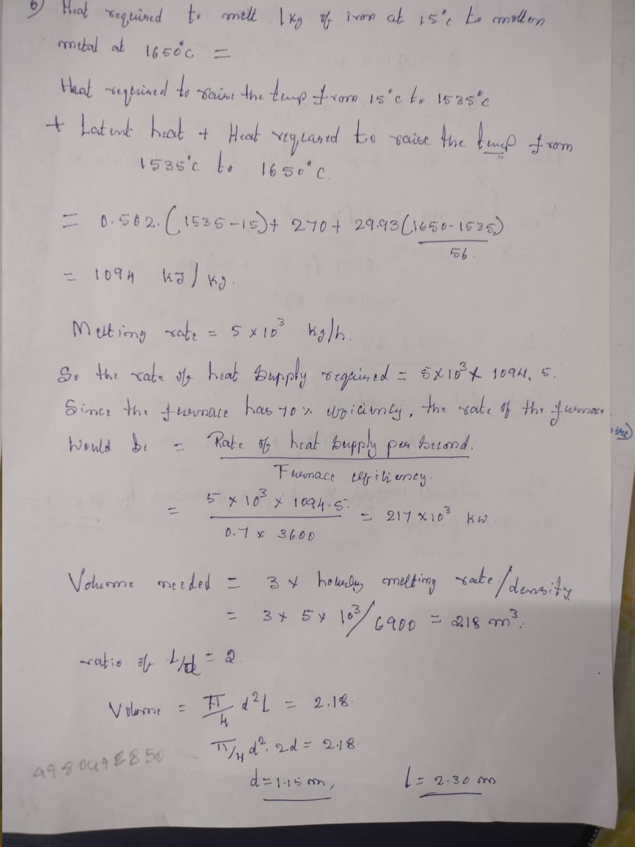
Q=mC(ΔT)

Slide 55
7) A stationary mass of gas is compressed without friction from an initial state of 0.3 m³ and 0.105 MPa to a final state of 0.15 m³ and 0.105 MPa, the pressure remaining constant during the process. There is a transfer of 37.6 kJ of heat from the gas during the process. How much does the internal energy of the gas change?

Slide 56
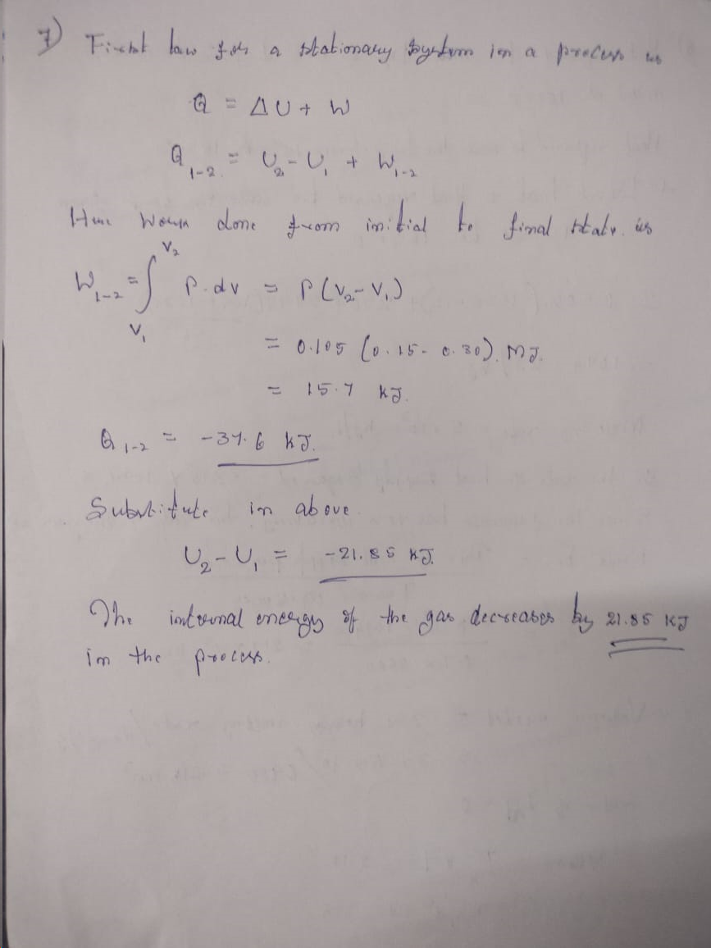

Slide 57
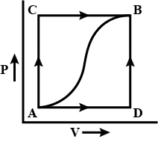
8) When a system is taken from state a to state b, along path acb, 84 kJ of heat flow into the system, and the system does 32 kJ of work. a) How much will the heat that flows into the system along path adb, if the work done is 10.5 kJ. b) When the system is returned from b to a along the curved path, the work done on the system is 21 kJ. Does the system absorb or liberate heat, and how much of the heat is absorbed or liberated, c) If Ua = 0 and Ud = 42 kJ, find the heat absorbed in the processes ad and db.

Slide 58
